Slide 1

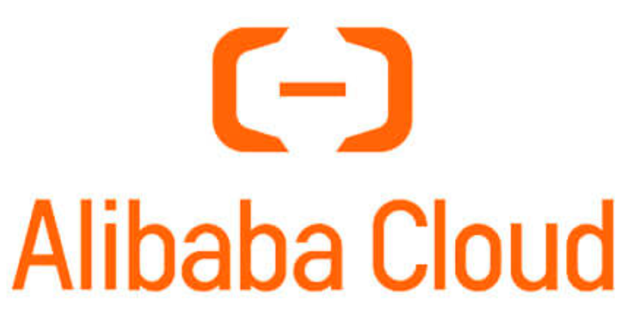
Zephyr: A Zero-Loss and Transparent TLS Connection
Migration Framework
Jiazhen Xu*, Chengcheng Yu*, Yueshang Zuo*, Enge Song, Shaokai Zhang, Jiangu Zhao, Tian Pan, Yang Song, Xing Li, Rong Wen, Wenzhi Chen, Shunmin Zhu, Chengkun Wei
*Joint first authors
Notes:
I am Jiazhen Xu from Zhejiang University. Today, I will present Zephyr, a zero-loss and client-transparent framework for migrating established TLS connections across nodes. This work was conducted jointly by researchers from Zhejiang University, Alibaba Cloud
[Sources]
Xu et al., “Zephyr: A Zero-Loss and Transparent TLS Connection Migration Framework,” APNet 2026.

Slide 2

Necessities for TLS Connection Migration
Cloud Infrastructure Overview
Back-end
Server
Front-end
L7-NF
Clients
TLS connection
Notes:
Let us begin with a typical cloud service path. A client's TLS connection passes through a front end Layer-7 network function before reaching the back-end server. The Layer-7 component may be a proxy, load balancer, gateway. Unlike stateless traffic, an established TLS connection carries TCP, TLS, and application-layer state. Connection migration must transfer the live connection and preserve all of these states consistently.

Slide 3
Necessities for TLS Connection Migration
Cloud Infrastructure Overview
Back-end
Server
Front-end
L7-NF
Clients
TLS connection
Seamless Mantenance -- software hot upgradation
  It needs to wait all long-lived connections to close, so
      connection draining may take days or weeks
Notes:
The first motivation is seamless maintenance, such as a software hot upgrade. The conventional approach stops accepting new connections and waits for existing ones to terminate naturally. This is known as connection draining. However, a long-lived connection may remain active for days or even weeks. As a result, a routine upgrade may require old instances to stay online for a long time, increasing both resource and operational costs. We therefore need per-connection migration instead of passively waiting for every connection to close.

Slide 4
Necessities for TLS Connection Migration
Cloud Infrastructure Overview
Back-end
Server
Front-end
L7-NF
Clients
TLS connection
Stateful services are sensitive to connection interruption
  LLM Inference --> Context Loss, waste resource to recompute
  IOT devices --> Reconnection storm
  Live streaming Apps --> Lags or video frame loss
Notes:
More importantly, many stateful services are highly sensitive to connection interruption. In LLM inference, a disconnection may lose conversational context and waste computation already spent on a request. In IoT systems, simultaneous reconnections can create a reconnection storm. In live streaming, reconnection appears directly as playback stalls or lost video frames. Reconnection is not enough. Migration should preserve the connection and remain invisible to the application and the client.

Slide 5
Existing Works and Drawbacks
VM / process migration [1]
  Coarse granularity, not per-flow
TCP connection migration [2, 3]
  No support for TLS or Layer-7 protocols
References
[1] CRIU.
[2] Capybara: μSecond-Scale Live TCP Migration. APSys’23
[3] HA/TCP: A Reliable and Scalable Framework for TCP Network Functions. NSDI’25
Missing: per-flow + cross-node + standard TLS + strict zero loss
Notes:
Existing approaches do not provide all four properties together: per-flow granularity, cross-node migration, compatibility with standard TLS stacks, and strict zero loss. VM or process migration is too coarse-grained. Capybara and HA/TCP migrate TCP state but do not directly support TLS and Layer-7 protocol state. Prism and XO may drop packets during migration or depend on lightweight TLS libraries and kTLS. Each line of work addresses part of the problem, but none provides a general solution for production-grade TLS long connections.

Slide 6
Existing Works and Drawbacks
VM / process migration [1]
  Coarse granularity, not per-flow
TCP connection migration [2, 3]
  No support for TLS or Layer-7 protocols
Dropping packets during migration [4, 5]
  Downgrade quality of service and throughput
Incomplete TLS compatibility
  lightweight TLS library [4]
  reliance on kTLS, not support 0-RTT feature [5]
  Insuffcient for production usage
References
[1] CRIU.
[2] Capybara: μSecond-Scale Live TCP Migration. APSys’23
[3] HA/TCP: A Reliable and Scalable Framework for TCP Network Functions. NSDI’25
[4] Prism: Proxies without the Pain. NSDI’21
[5] Remote TCP Connection Offload and Applications. NSDI’26
Missing: per-flow + cross-node + standard TLS + strict zero loss
Notes:
Existing approaches do not provide all four properties together: per-flow granularity, cross-node migration, compatibility with standard TLS stacks, and strict zero loss. VM or process migration is too coarse-grained. Capybara and HA/TCP migrate TCP state but do not directly support TLS and Layer-7 protocol state. Prism and XO may drop packets during migration or depend on lightweight TLS libraries and kTLS. Each line of work addresses part of the problem, but none provides a general solution for production-grade TLS long connections.

Slide 7
Challenges
Consistency of inflight packets
  Buffering mechnism with sufficient capacity
  Flexible and efficient buffer management
Notes:
The first design challenge is maintaining consistency for in-flight packets. After the connection is frozen, packets already in the network may still arrive at the destination. Delivering them to a protocol stack that has not yet been restored would corrupt the connection state. A simple packet buffer is also insufficient: its capacity must cover the worst-case amount of unacknowledged data, while isolating and managing many connections efficiently. Zephyr therefore needs a sufficiently large, flexible, and low-overhead buffering mechanism for zero-loss handover.

Slide 8
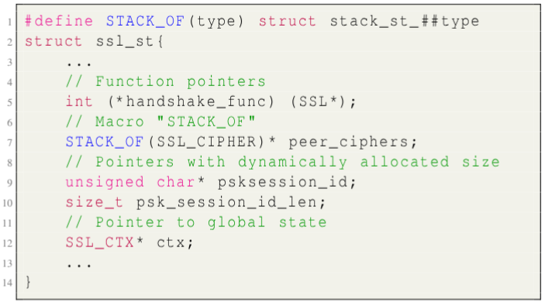
Challenges
Consistency of Inflight Packets
  Buffering mechnism with sufficient capacity
  Flexible and efficient buffer management
Complexity of TLS State Migration
  Semantic copy of function pointers
  Determine the memory footprint of structures
  Identify connection states from global states
Openssl state example
Reconstruct every state is engineeringly infeasible
Notes:
The second challenge is the complexity of TLS state migration. An OpenSSL connection is not a contiguous memory object that can be copied directly. It contains function pointers, dynamically allocated structures, references to global state, and information tied to the current position of the TLS state machine. Reconstructing every field manually would be error-prone, extremely labor-intensive, and tightly coupled to a particular OpenSSL version. We need a low-intrusion approach that allows the standard TLS implementation to reconstruct most of its own internal state.

Slide 9
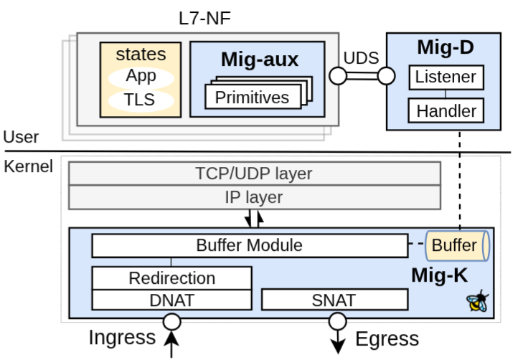
Zephyr: Architecture
Mig-K :
Data Plane -- eBPF TCX programs
  Network Address Translation(NAT)
  Redirection
  Buffer Module
Mig-D:
  Control Plane for migration task
Mig-aux:
  Hook points and primitives for states serialization and restoration
System Components
Notes:
This slide presents the overall Zephyr architecture. Mig-K runs in the data plane and uses eBPF TCX programs for address translation, redirection, and packet buffering. Mig-D is the control plane that coordinates the migration task and its execution stages. Mig-aux provides a small set of hook points and primitives for serializing and restoring connection state. This separation keeps per-packet processing on the kernel fast path, places complex coordination in user space, and limits modifications to existing applications and TLS libraries.

Slide 10
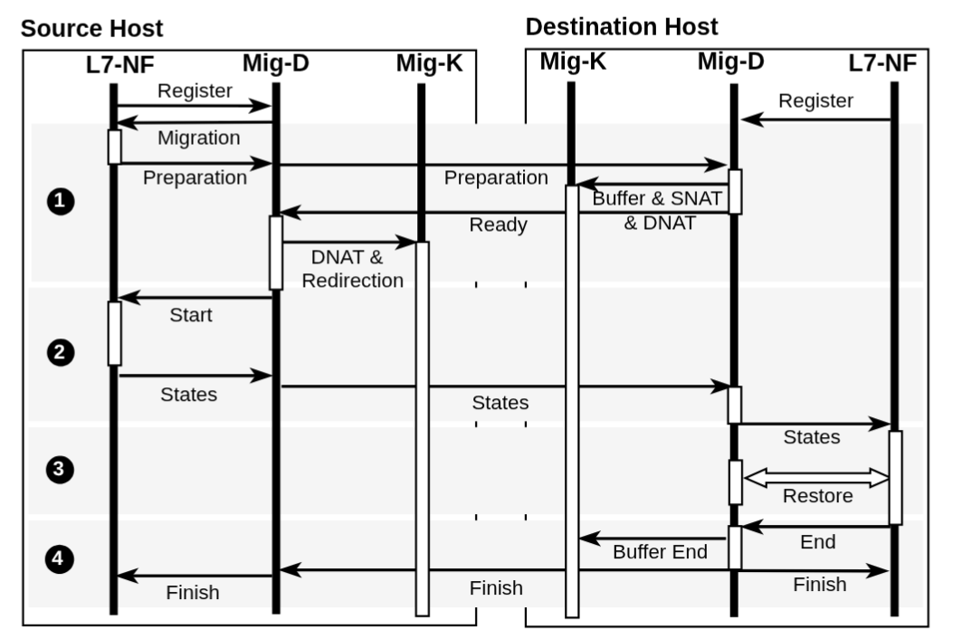
Zephyr: Migration Protocol
Preparation
  initialize eBPF maps and rules
State transfer
  Freeze the connection and serialize states
Restoration
  Connection restoration for L7/TLS/TCP states
Finish
  End the buffer and release resources
Notes:
Zephyr's migration protocol has four stages. The first is preparation. The control plane creates migration contexts on the source and destination, initializes the required eBPF maps, and installs rules that match the target connection. During this stage, the connection continues running normally on the source node, so preparation introduces no service interruption. Only after all required resources and rules are ready does Zephyr begin the actual state transition.

Slide 11
Zephyr: Migration Protocol
Preparation
  initialize eBPF maps and rules
State transfer
  Freeze the connection and serialize states
Restoration
  Connection restoration for L7/TLS/TCP states
Finish
  End the buffer and release resources
Notes:
The second stage is state transfer. Zephyr briefly freezes the target connection at the source to prevent its state from changing. It then serializes and transfers the required Layer-7, TLS, and TCP state to the destination. This freeze interval accounts for most of the service pause, so the goal is to transfer only the state needed for restoration. Meanwhile, the packet-buffering mechanism takes responsibility for traffic that continues to arrive during migration.

Slide 12
Zephyr: Migration Protocol
Preparation
  initialize eBPF maps and rules
State transfer
  Freeze the connection and serialize states
Restoration
  Connection restoration for L7/TLS/TCP states
Finish
  End the buffer and release resources
Notes:
The third stage is restoration. At the destination, Zephyr restores the connection according to the dependencies across the protocol stack. It prepares the underlying connection environment and then reconstructs the TCP, TLS, and Layer-7 state so that the new connection reaches the same logical point at which the source was frozen. Throughout restoration, newly arriving packets remain buffered by Mig-K and cannot enter the protocol stack before it is ready.

Slide 13
Zephyr: Migration Protocol
Preparation
  initialize eBPF maps and rules
State transfer
  Freeze the connection and serialize states
Restoration
  Connection restoration for L7/TLS/TCP states
Finish
  End the buffer and release resources
Notes:
The final stage completes the migration. After the destination confirms that the connection has been restored, Zephyr switches the data path and replays the buffered packets into the normal network stack. It then ends packet capture, releases the source-side connection, and cleans up temporary migration resources. By coordinating preparation, state transfer, restoration, and completion, the protocol preserves both connection-state consistency and packet continuity.

Slide 14
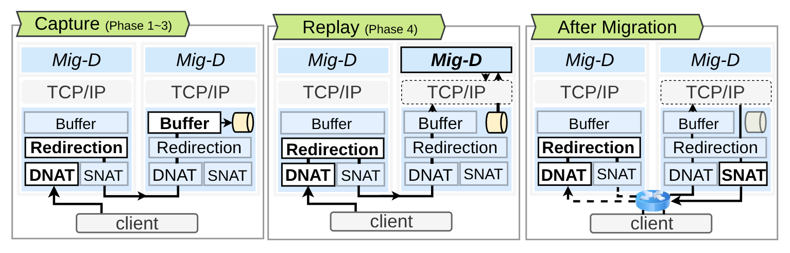
Zephyr: Zero-loss Handover Mechanism
Buffering workflow
Capture: store the packets in eBPF maps
Replay: re-inject packets to the raw AF_PACKET socket
Buffer management
Map-in-map hierarchy using the eBPF map type BPF_MAP_TYPE_HASH_OF_MAPS
Buffer capacity set to the tcp_rmem maximux
Notes:
Now I will explain the zero-loss handover mechanism in more detail. During capture, an eBPF TCX program at the destination ingress identifies packets belonging to the migrating connection, stores them in eBPF maps, and drops the original copies before they reach the incomplete stack. The packets themselves are not lost; they have already been captured. After restoration, Mig-D drains the buffer and reinjects the packets through a raw AF_PACKET socket. A map-in-map hierarchy isolates per-connection buffers, and the capacity is based on the maximum tcp_rmem value, which upper-bounds the unacknowledged data allowed by the TCP receive window.

Slide 15
Zephyr: Transparent TLS connection Migration
Q: How to restore TLS States with minimal intrusion to OpenSSL?
Notes:
Next, we turn to TLS migration. Our objective is not to reimplement OpenSSL's internal state machine. Instead, we ask a different question: can we make standard OpenSSL reconstruct the correct state with minimal intrusion? Copying every internal field would easily miss implicit dependencies and would break as the implementation evolves. Zephyr therefore looks for an existing, standards-compliant TLS mechanism that already reconstructs a live session state.

Slide 16
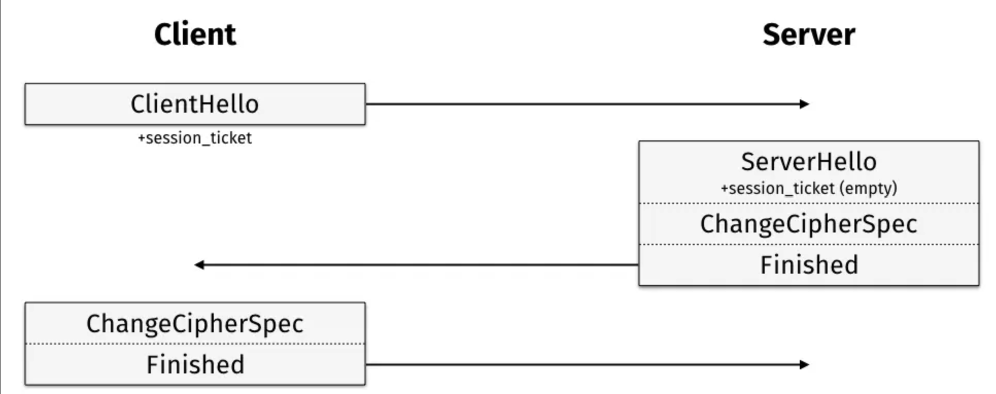
Zephyr: Transparent TLS connection Migration
Q: How to restore TLS States with minimal intrusion to OpenSSL?
Use TLS session resumption to reconstruct most states , e.g. state machines, for the destination server. Only inject the key materials.
Insight
TLS session resumption
Notes:
The key insight is to reuse TLS session resumption. Session resumption normally allows a client to reconnect to the same service without performing a full handshake. During this process, OpenSSL reconstructs its state machine and most of the session context by itself. Zephyr triggers this existing reconstruction path at the destination and injects only the key material required for migration. This greatly reduces implementation complexity while retaining compatibility with the standard, production-grade OpenSSL stack.

Slide 17
Zephyr: Transparent TLS connection Migration
Q: How to restore TLS States with minimal intrusion to OpenSSL?
Observations:
The server and client have identical session context after the initial handshake.
TLS session resumption is usually used when the client reconnects to the same site. The client send a server-issued session ticket to start TLS session resumption.
Contruct a “fake client” to init TLS session resumption on the destination node.
    fake client = server’s session context + server’s session ticket
Notes:
Why is this possible? After the initial handshake, the client and server hold corresponding session context, and the client also holds a session ticket issued by the server. Zephyr uses the server-side session context together with the server-issued ticket to construct a fake client at the destination. This fake client initiates a local TLS session resumption. It is not the real remote client and does not change client behavior; it simply drives OpenSSL through its standard handshake path to rebuild the destination-side connection state.

Slide 18
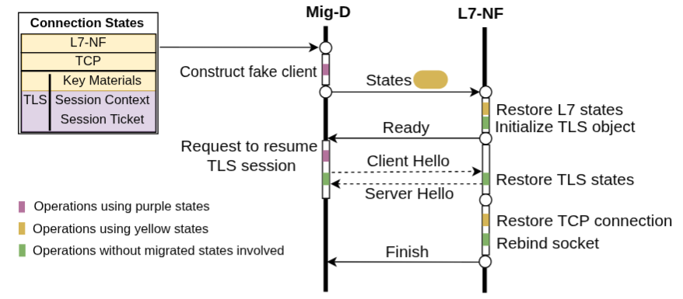
Zephyr: Transparent TLS connection Migration
Restoration workflow
Security Assumption:
All components work without any privileged compromise, and communicate in trusted(encrypted) channels.
Notes:
This slide summarizes the complete restoration workflow. After freezing the connection, the source securely transfers the required session context, ticket, key material, and TCP and application state. At the destination, the fake client performs a controlled session resumption with the server, allowing OpenSSL to reconstruct its internal state. Zephyr then injects the migrated keys, binds the restored TCP and Layer-7 state, and switches the real data path. Our security assumption is that all Zephyr components remain uncompromised and communicate over trusted, encrypted channels.

Slide 19
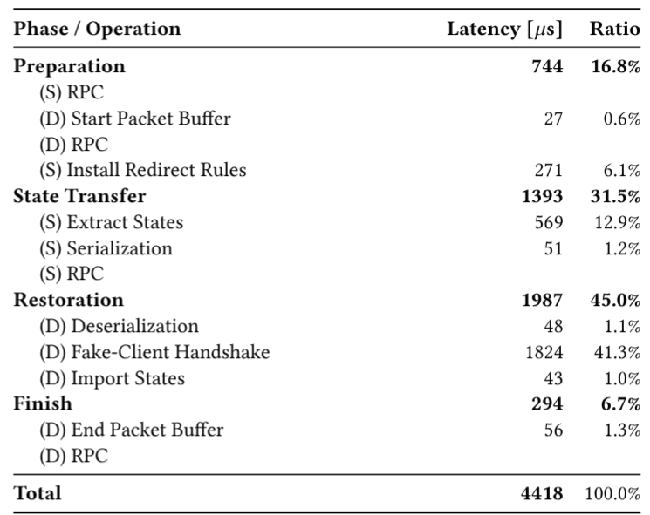
Preliminary Evaluation
End-to-end migration latency: 4.4ms
Fake-client handshake: 1.8ms (41%)
RPC calls: 1.2ms (27%)
State processing: 0.7ms (16%)
eBPF operations: 0.35ms (8%)
Latency breakdown
Notes:
Our preliminary results show an end-to-end migration latency of about 4.4 milliseconds. The fake-client handshake takes approximately 1.8 milliseconds, or 41 percent, and is the largest component. RPC calls take about 1.2 milliseconds, state processing takes 0.7 milliseconds, and eBPF operations take only around 0.35 milliseconds. This breakdown indicates that the kernel data-plane operations are not the primary bottleneck. Future latency optimization should focus mainly on the handshake path and cross-component coordination.

Slide 20
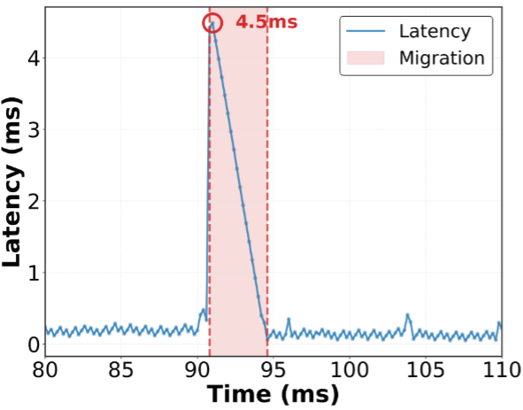
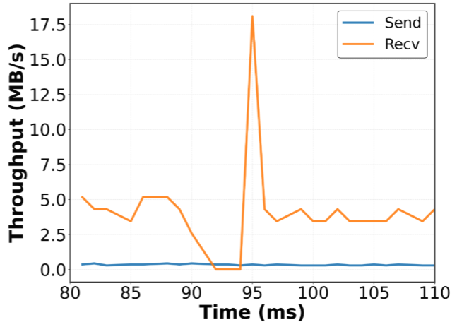
Preliminary Evaluation
Network Performance Implications
Latency
Throughput
A 4.5ms spike
No RTO (200ms)
Only drop during migration
Notes:
We also examine the impact on network performance. Zephyr introduces only a short latency spike of about 4.5 milliseconds at the migration point. Because packets are buffered and subsequently delivered, the connection does not trigger a retransmission timeout, whose minimum is typically around 200 milliseconds, and throughput remains stable. By contrast, directly dropping packets during the same short migration interval can cause retransmissions, congestion-window reduction, and a much longer throughput penalty. In other words, Zephyr converts a loss event into a controlled, millisecond-scale queueing delay.

Slide 21
In-progress Work
01 Extend protocol compatibility
Support legacy TLS 1.2 and stateful L7 protocols, such as MQTT, RTMP, WebSocket, and HTTP/2.
02 Scale concurrent migrations
Optimize control plane coordination for production-scale migration batches.
03 Add failure-safe rollback
Detect anomalies and restore the pre-migration state without interrupting the connection.
Toward a deployable migration substrate for diverse, large-scale services
Notes:
We are now extending Zephyr from a prototype into a deployable migration substrate for diverse, large-scale services. First, we are adding support for legacy TLS 1.2 and stateful Layer-7 protocols such as MQTT, RTMP, WebSocket, and HTTP/2. Second, we are optimizing control-plane coordination for production-scale batches of concurrent migrations. Third, we are developing failure-safe rollback, so that Zephyr can detect an anomaly and restore the pre-migration state without interrupting the connection. These directions address protocol coverage, scalability, and reliability, respectively.

Slide 22
Conclusion
Zephyr achieves the following propeties:
Zero-Loss Handover:
  In-flight packets arriving during migration are be dropped.
Client-Transparency:
  The migration process is transparent to the client endpoint.
  No need for modification of the client software.
Broad Compatibility:
  The framework integrate with standard, production-grade software stacks, like OpenSSL and Linux.
Notes:
To conclude, Zephyr aims to provide three properties simultaneously: zero-loss handover, client transparency, and broad compatibility with standard production software stacks. It buffers in-flight packets with eBPF, reconstructs OpenSSL state through fake-client session resumption, and completes an end-to-end migration in about 4.4 milliseconds. One clarification is important for the first bullet on this slide: packets arriving during migration are not lost. They are captured, buffered, and replayed after restoration.

Slide 23
Thank You
Jiazhen Xu
Zhejiang University
jiazhenx@zju.edu.cn
Notes:
That concludes my presentation. Zephyr takes a TLS connection that is normally bound to one process and one node, and turns it into a fine-grained resource that can move safely within cloud infrastructure. Thank you for your attention. I would be happy to take questions about zero-loss handover, TLS state restoration, protocol compatibility, or large-scale connection migration.

